Slide 1


FlyNet: Autonomous Quadcopter Search and Rescue
System | Mass [kg] | Power [W] | Est. Endurance [min]
M100 | 2.71 | 16 | 12.7
AlienBee w/ RGBD | 1.52 | 8.1 | 24.2
AlienBee w/ Guidance | 1.63 | 17.1 | 18.4

Slide 2
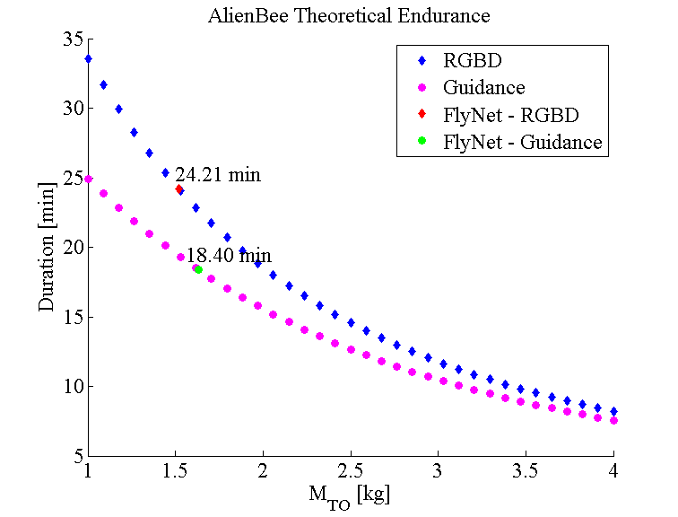
FlyNet: Autonomous Quadcopter Search and Rescue

Slide 3
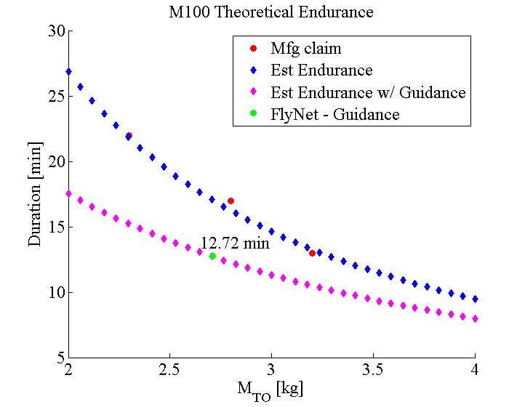
FlyNet: Autonomous Quadcopter Search and Rescue

